Slide 1
Churn Analysis
Sreepriya Meerel

Slide 2

Business Understanding & Overview
This case study utilized a dataset concerning the Telecom Industry.
Exploratory Data Analysis (EDA) was performed to extract valuable insights, and the resultant conclusions are provided.
These conclusions aim to assist the company in making informed decisions to enhance customer retention efforts.

Slide 3

Understanding the data

Slide 4
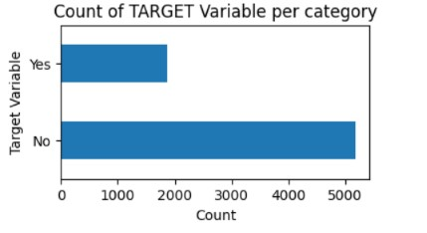
Target Data
In this EDA, “Churn” was considered as target variable.
Data was found to be highly imbalanced, with a ratio of 73:27.
To understand target variable in more depth, both univariate and bivariate analysis was performed to get some useful insights about factors affecting customer churning, so as to help company to plan adequate future actions.

Slide 5
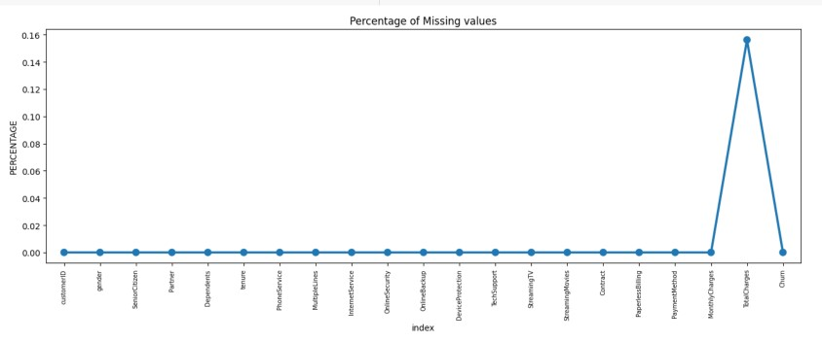
Missing Data
Total Charges column was found to have some null values.
Since the percentage of these missing data was found to be low- 0.15% compared to the whole dataset, these columns were dropped.
These values contribute very less insight on analysis so can be dropped safely.

Slide 6

Initial Intuition from the data
Some columns such as ‘Customer Id’, which have no impact for analysis were deleted.
Bins were created for the column ‘Tenure’ for the ease of analysis and a new column name ‘Tenure group’ was created by grouping the data in bins of 12 months following which ‘Tenure ‘column was removed .

Slide 7

Univariate Analysis:
Analysis was done by plotting multiple distribution graphs of individual predictors(dependent variable) by churn(target variable).

Slide 8
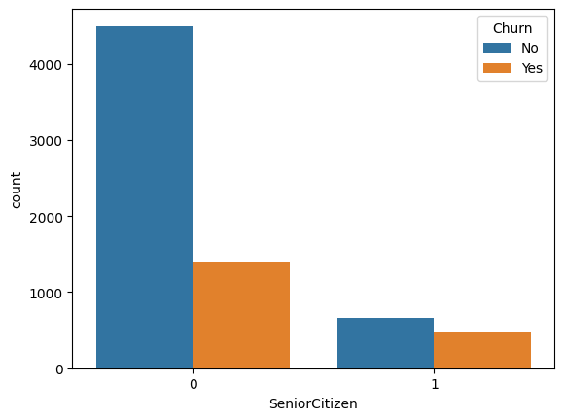
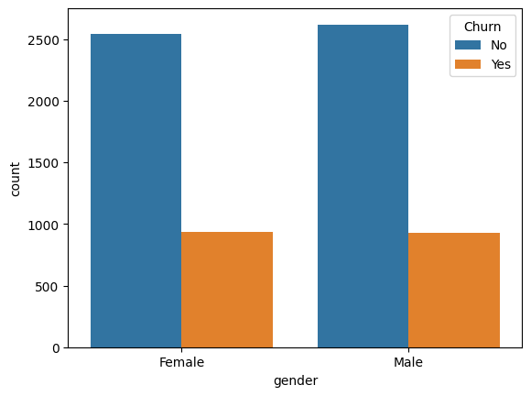
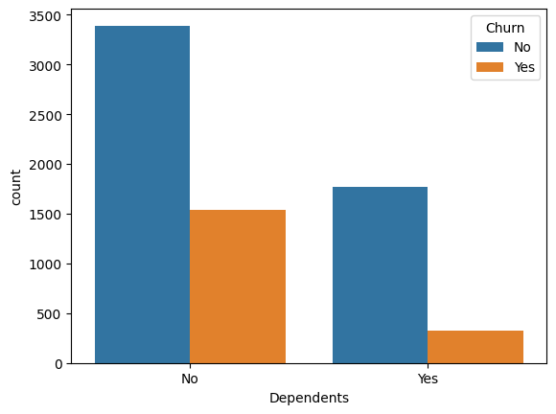
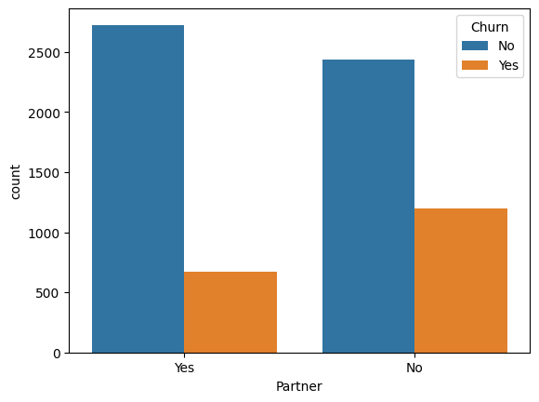
Findings:
Senior citizens are more likely to churn
Gender shows no impact on churn.
Higher churn tendency in customers without partner
Customers without any dependents show higher churn rate.

Slide 9
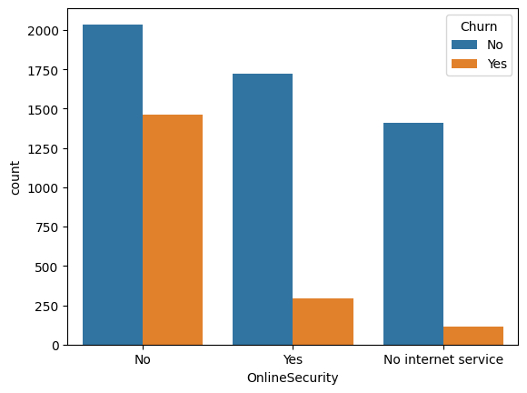
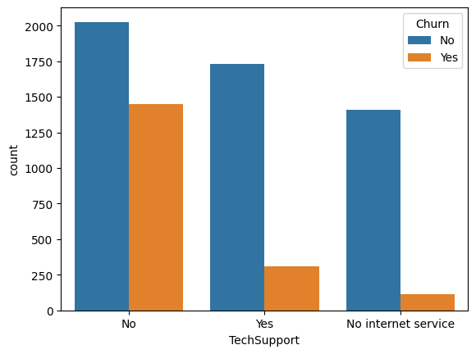
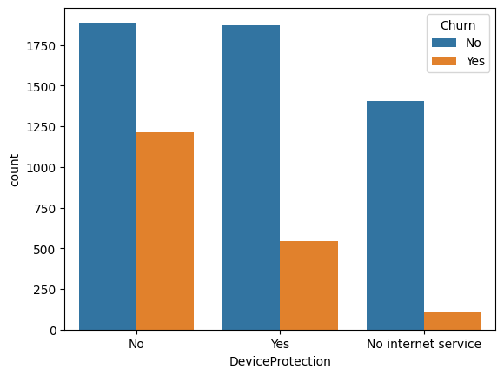
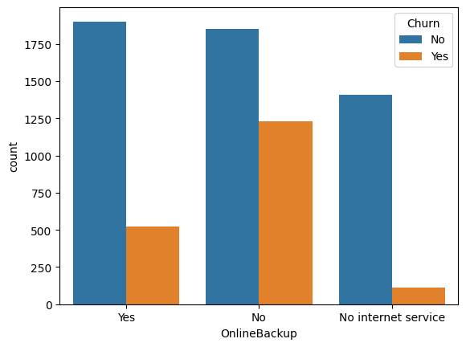
Findings:
**Churn likelihood is higher in users without Online security, No Tech support, No Online Backup and No Device protection

Slide 10
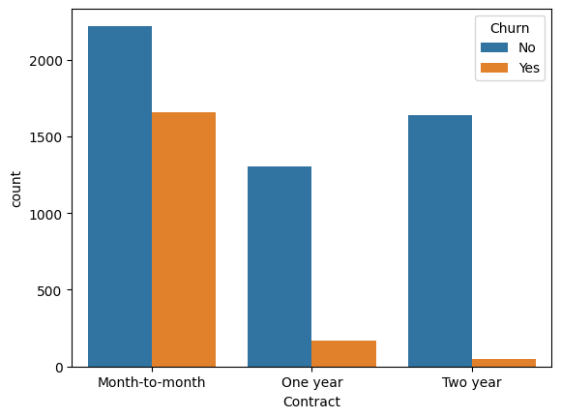
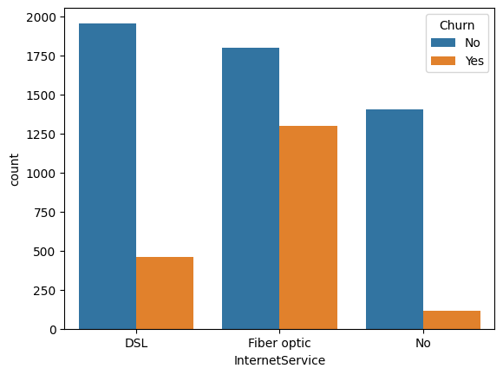
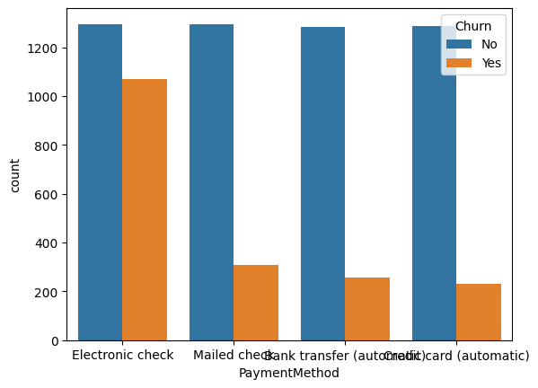
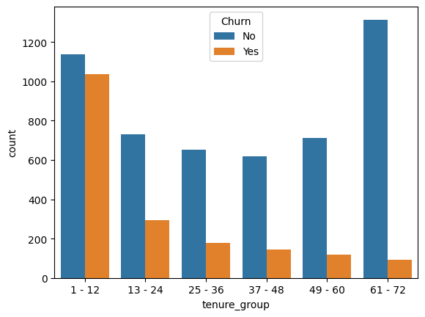
Findings:
Churn rates are higher for month-to-month contract
Higher churn seen with Fiber optic service
Electronic check payment method shows more churn.
New customers are more likely to churn

Slide 11
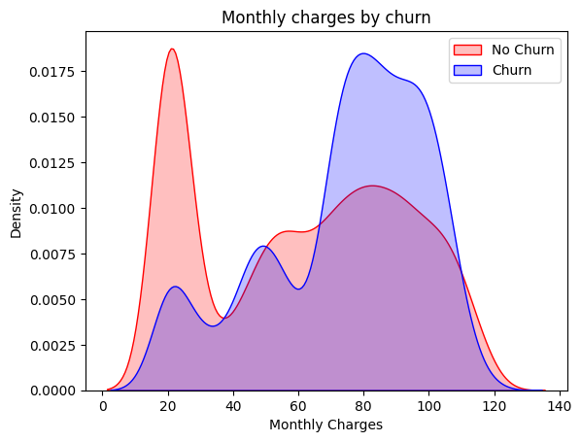
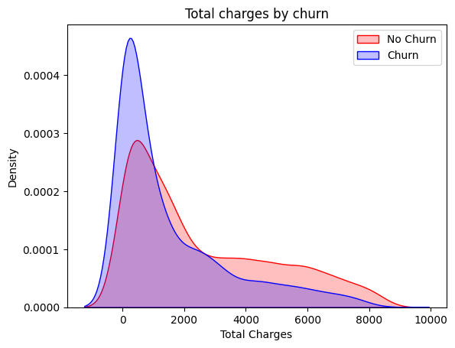
Findings:
Churn is high when Monthly Charges are high.
Higher Churn at lower Total Charges

Slide 12
Univariate Analysis Findings:
Senior citizens are more likely to churn (churn rate - 41.68%).
The univariate analysis with respect to Gender and Multiple have no impact on churn .
Customers without partner are more likely to churn(~ 33%)as compared to customers with partners(19.7%).
Churn is more likely to occur with customers without any dependents(31.3%) than those who have dependents(15.5%).
The Phone Service seems to have insignificant effect on churning in univariate analysis as both users with and without phone service have almost similar churn rate ~25-26%.
Customers without internet service are less likely to churn(7.4%) and among internet service users, those using fiber optic are more likely to churn ~42%.
Consumers are more likely to churn in the absence of Online security(41.7%), unavailability of Online Backup (~40%) and Tech support(41.6%), and in the absence of Device protection (39%).
Month-to-month contract are more likely to churn~42.7%.
Paperless billing (33.6%) and high monthly charges are more likely to churn.
Consumers opting for Electronic check payment method show increased tendency to churn (45.28%).
Tenure group falling within 1-12 months show higher to churn rate(47.68%).
Higher Churn is evident at lower Total Charges which indicates older customers are less likely to churn.

Slide 13

Bivariate Analysis :
Analysis was done by comparing two variables to understand their relationship better.
Distribution graphs were plotted for all dependent factors to examine relationship between dependent and independent factors.

Slide 14
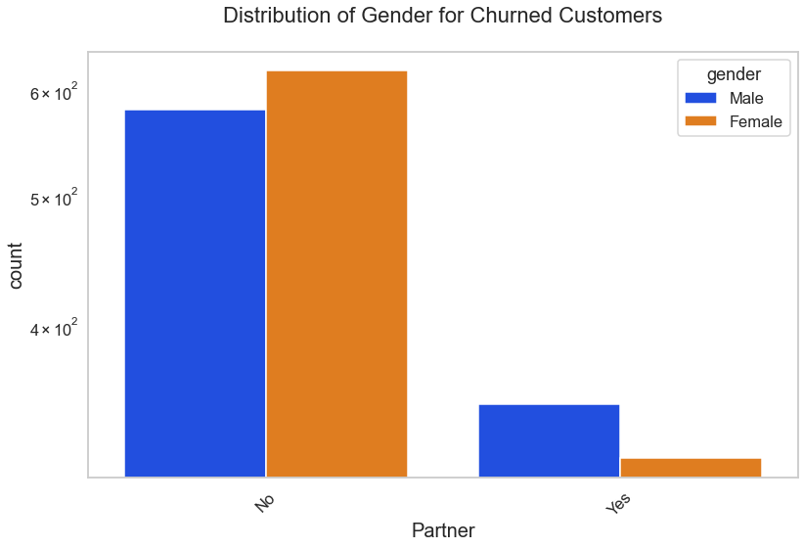
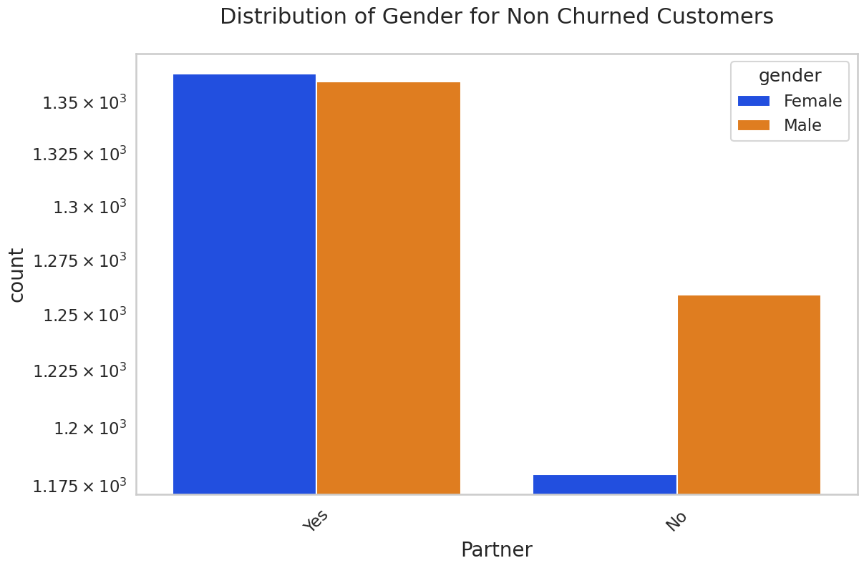
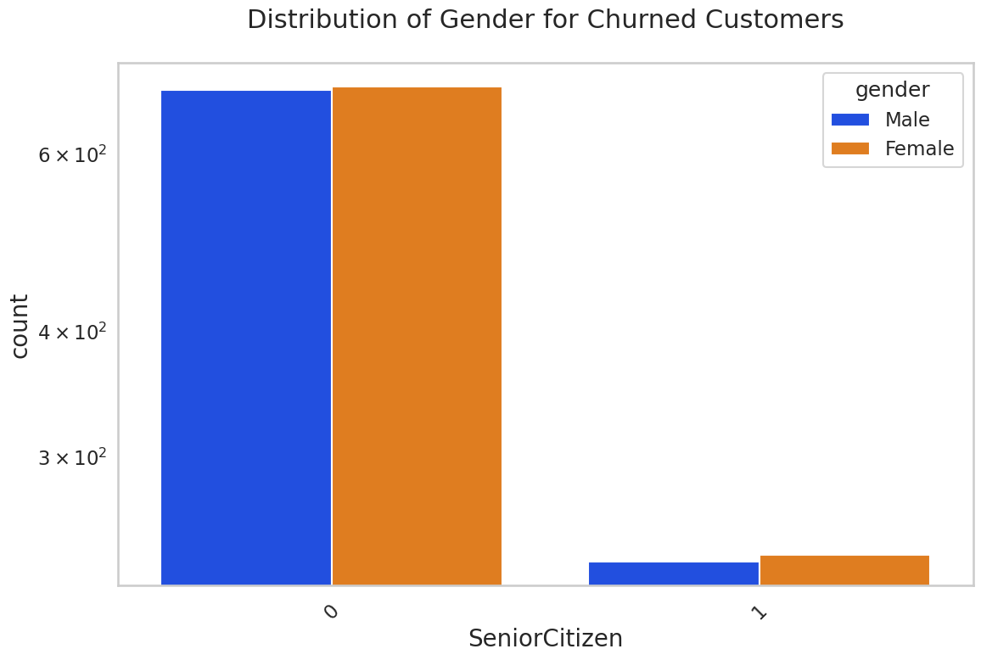
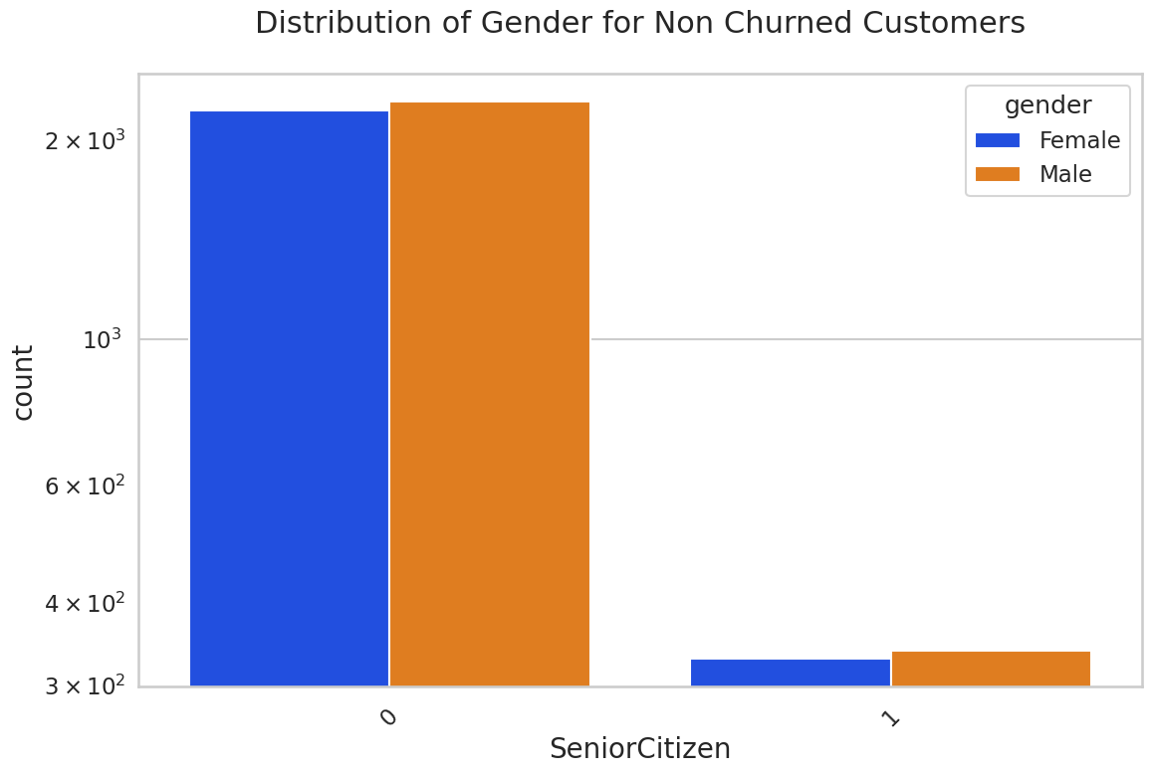
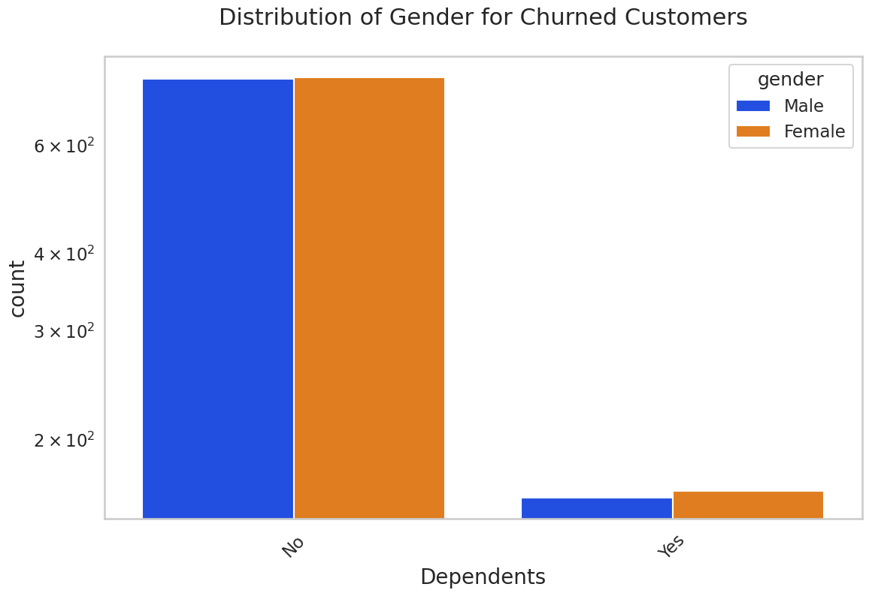
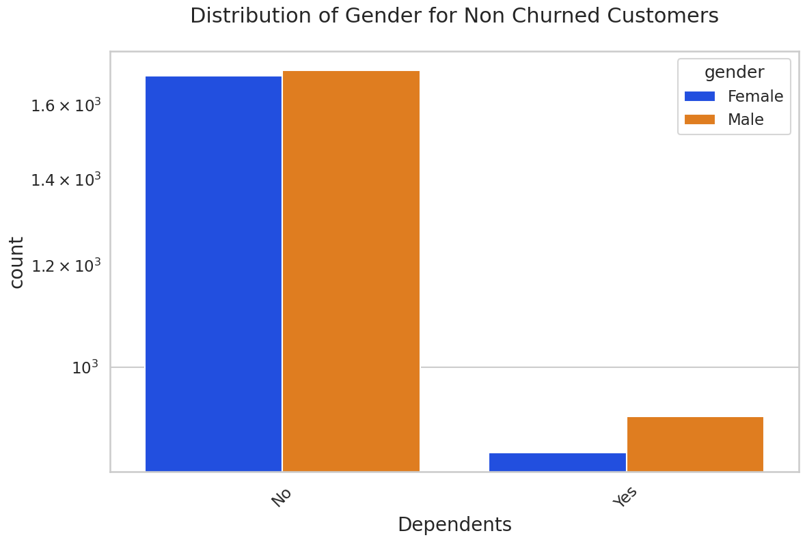
Findings:
Gender does not have any significant impact on tendency to churn.

Slide 15
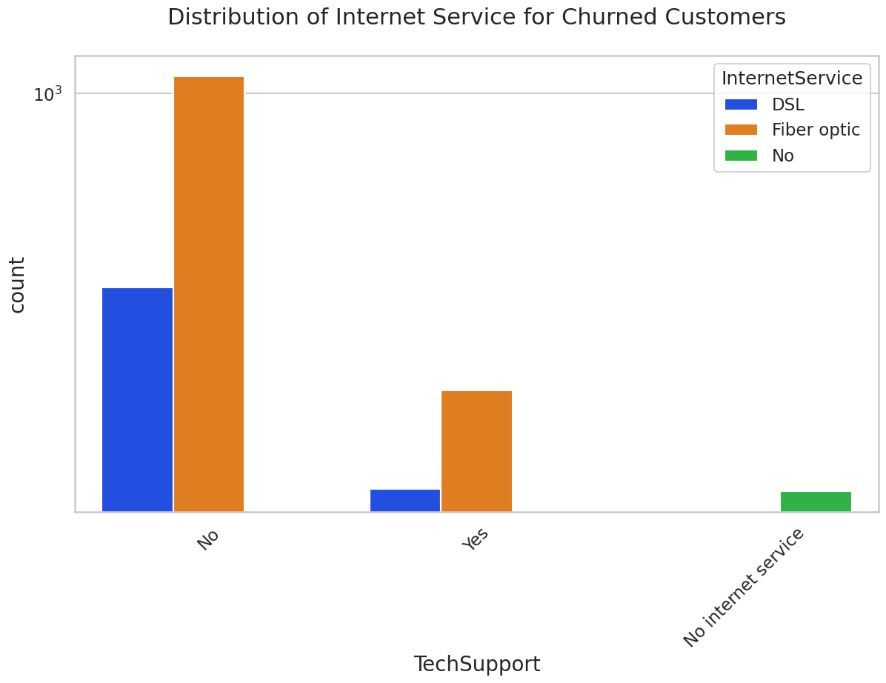
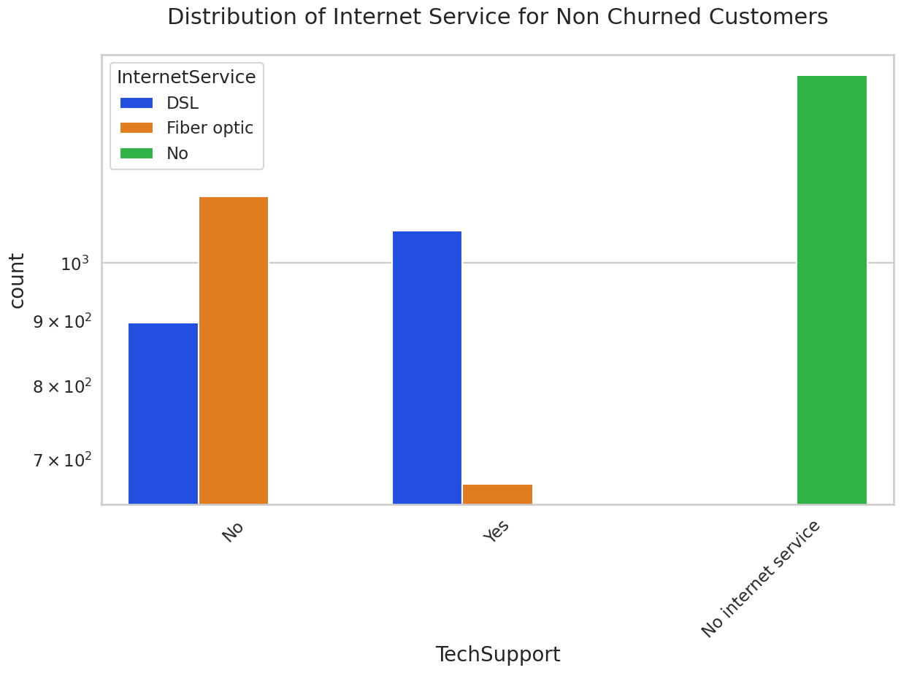
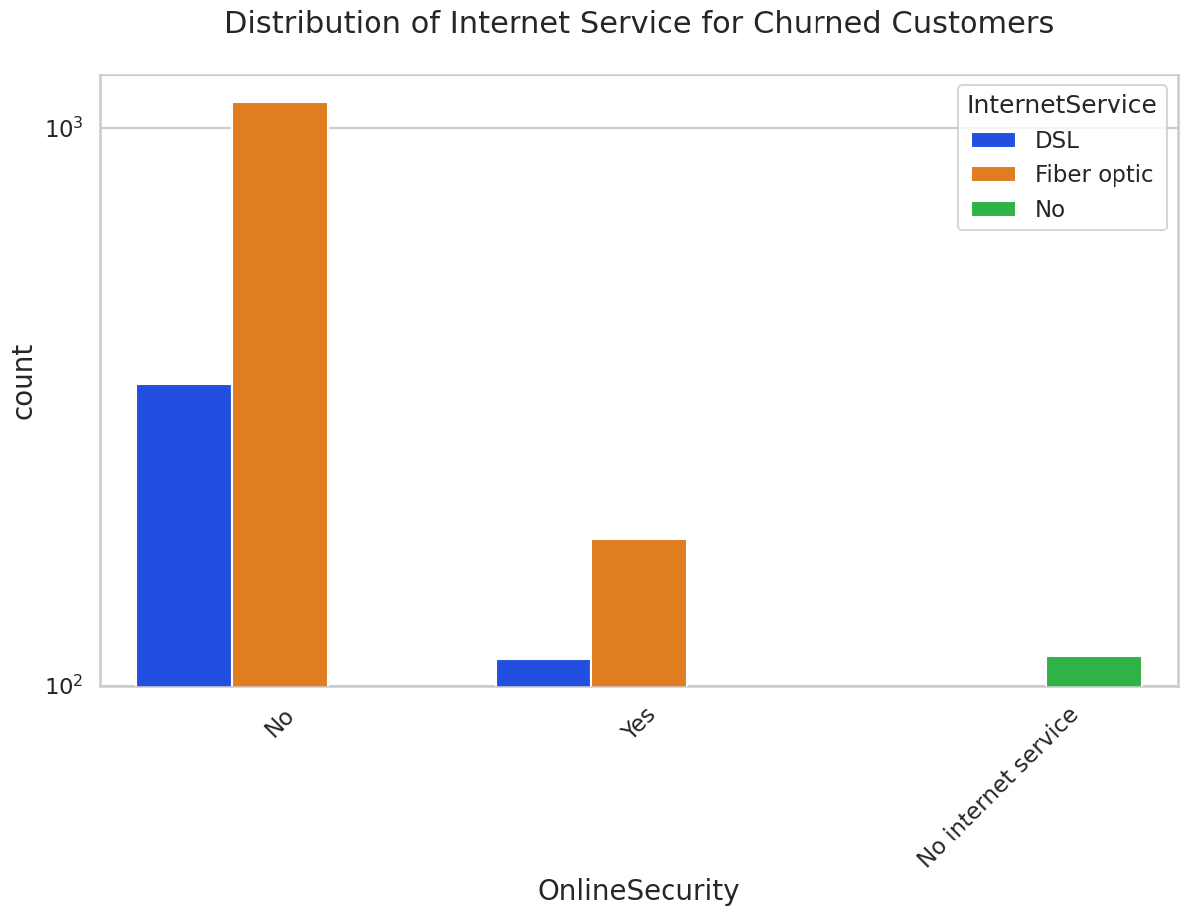
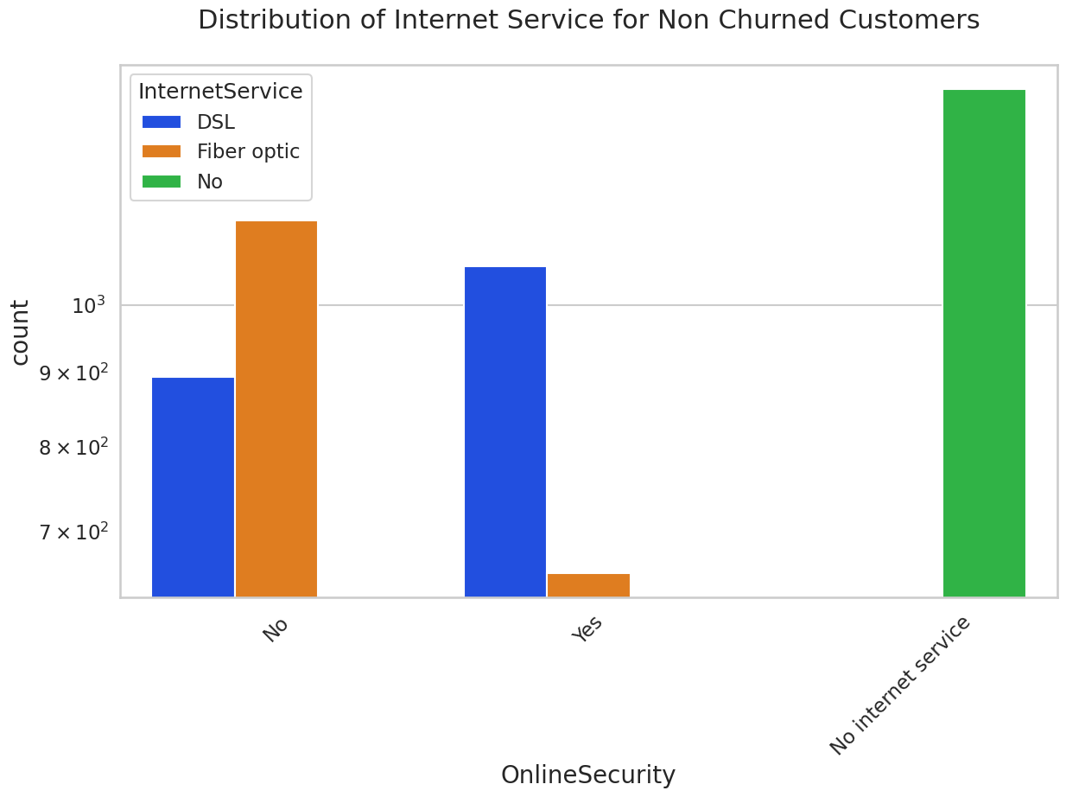
Findings:
Customers without Online security, No Tech support, No Online Backup and No Device protection show higher tendency to churn.
Churn rate is very low without internet subscription.

Slide 16
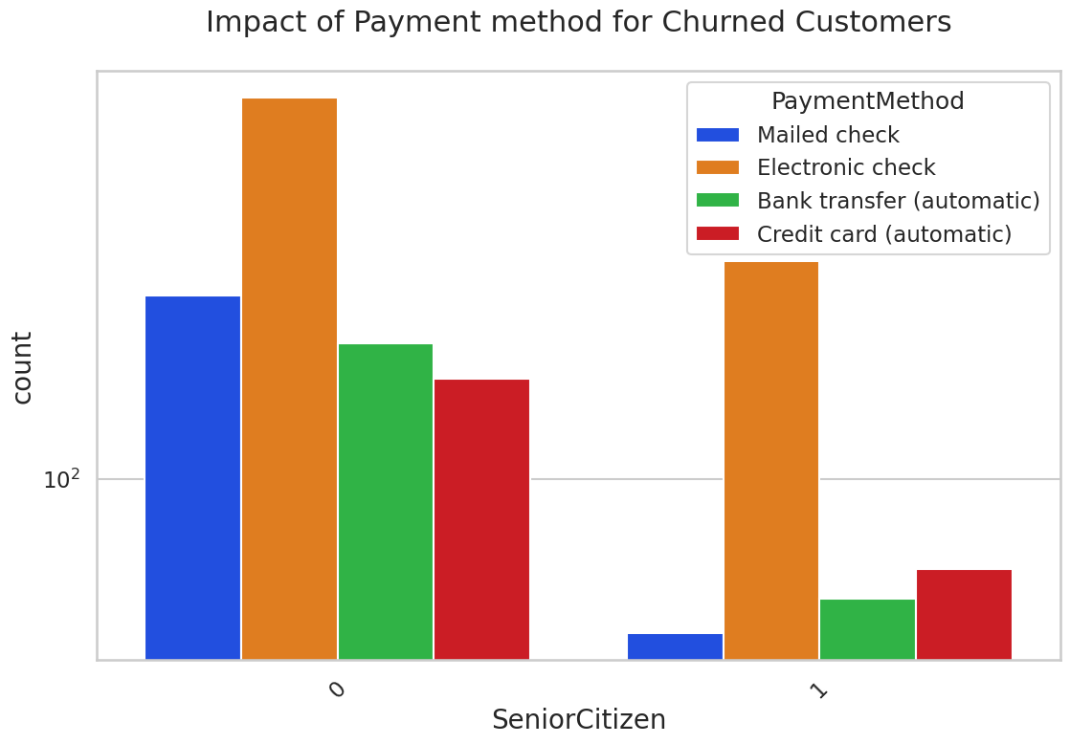
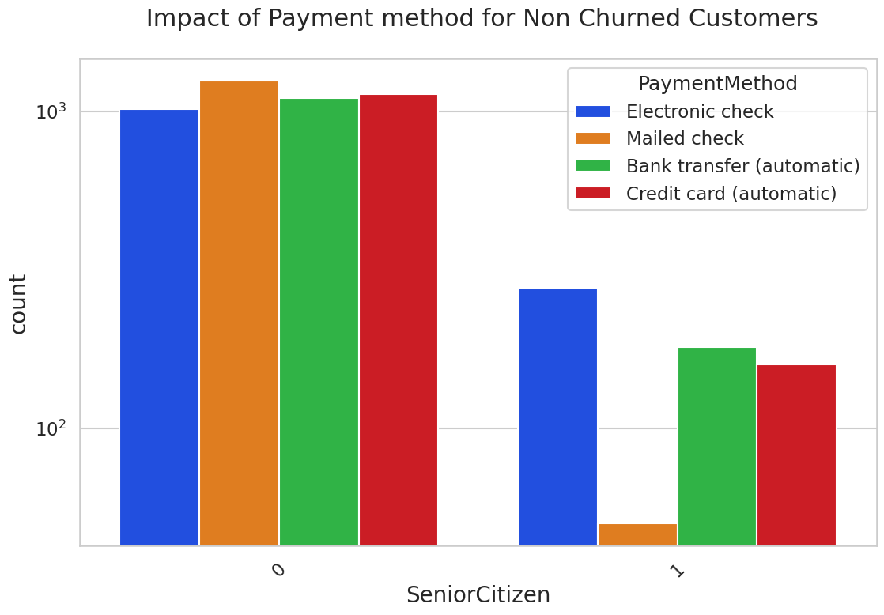
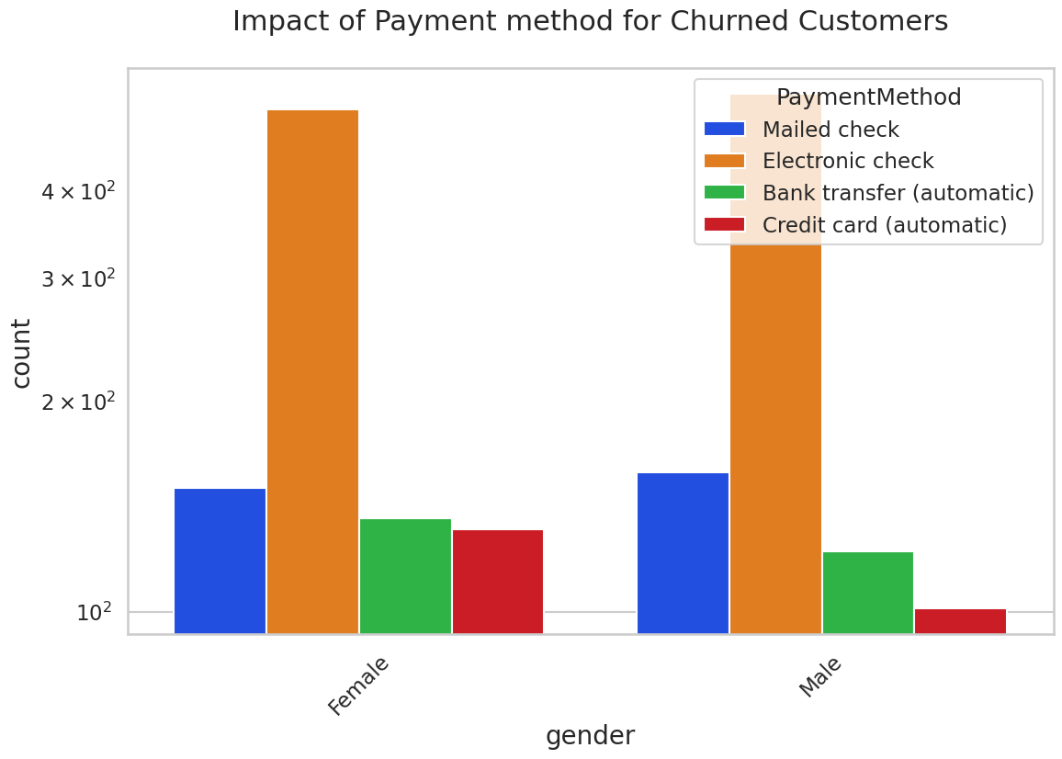
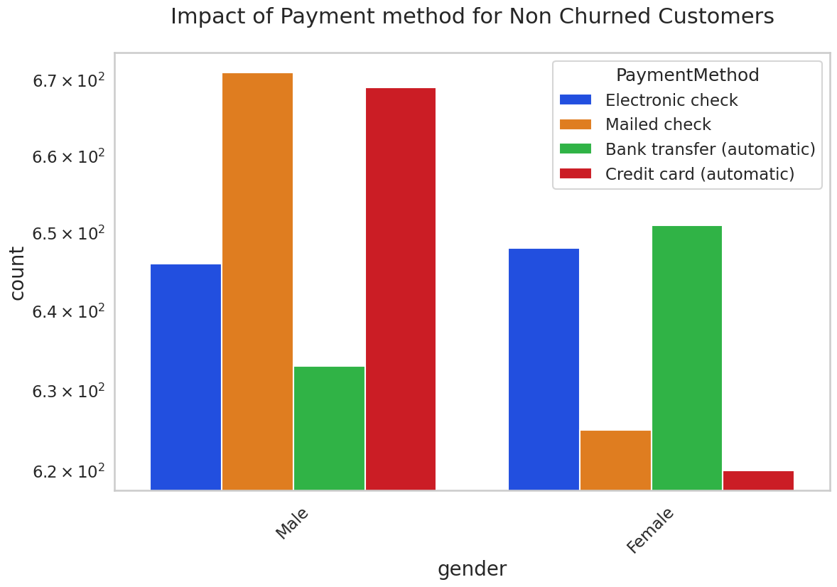
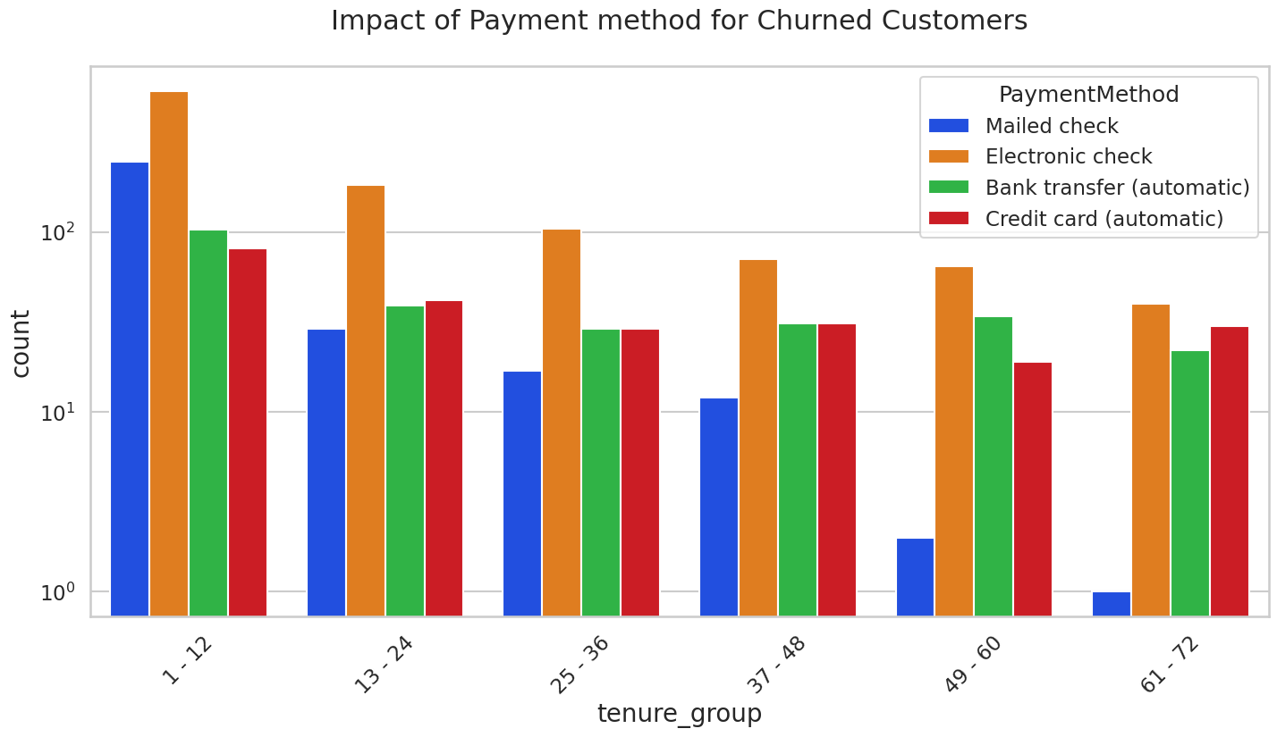
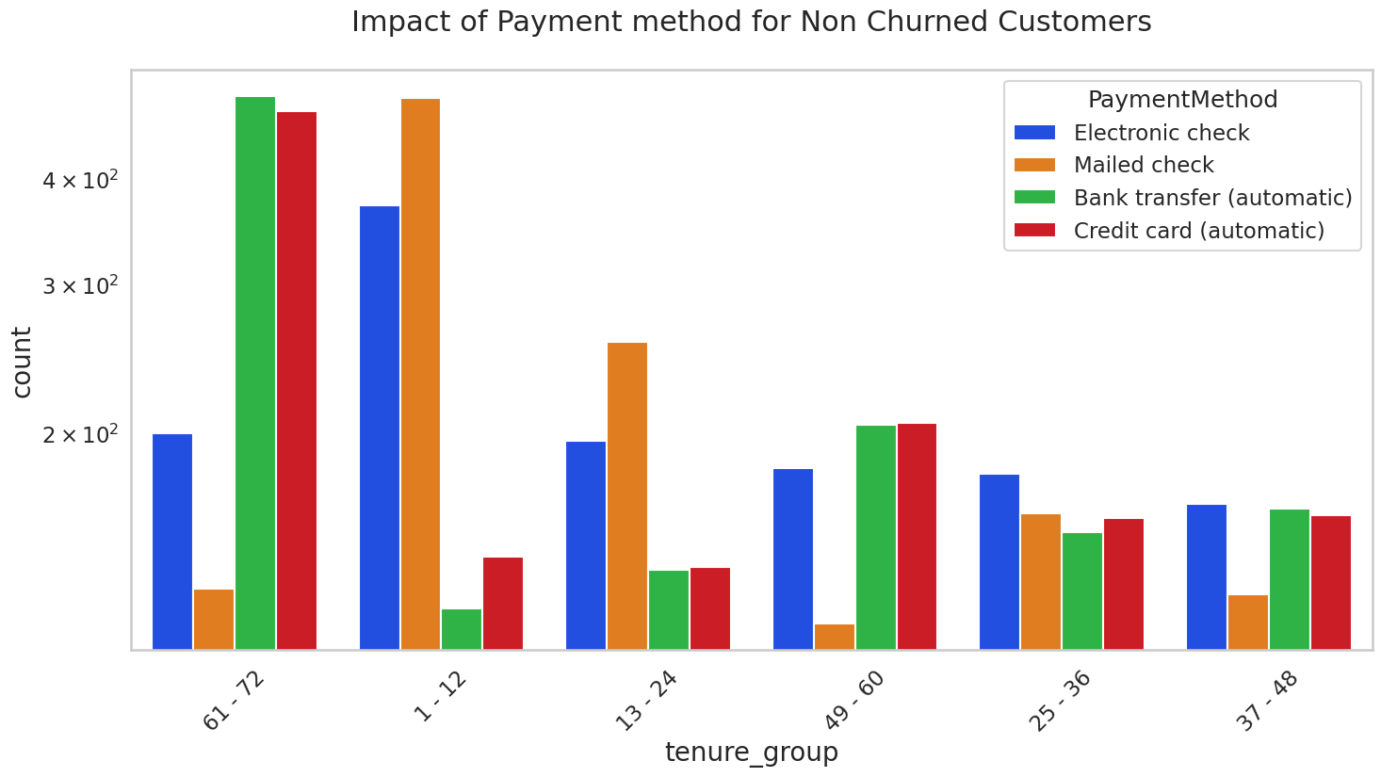
Findings:
Customers using Electronic check payment methods are more likely to churn regardless of age, gender or tenure length.
Senior citizens paying via Electronic check have higher churn rate.
Female customers using credit cards are more likely to churn.

Slide 17
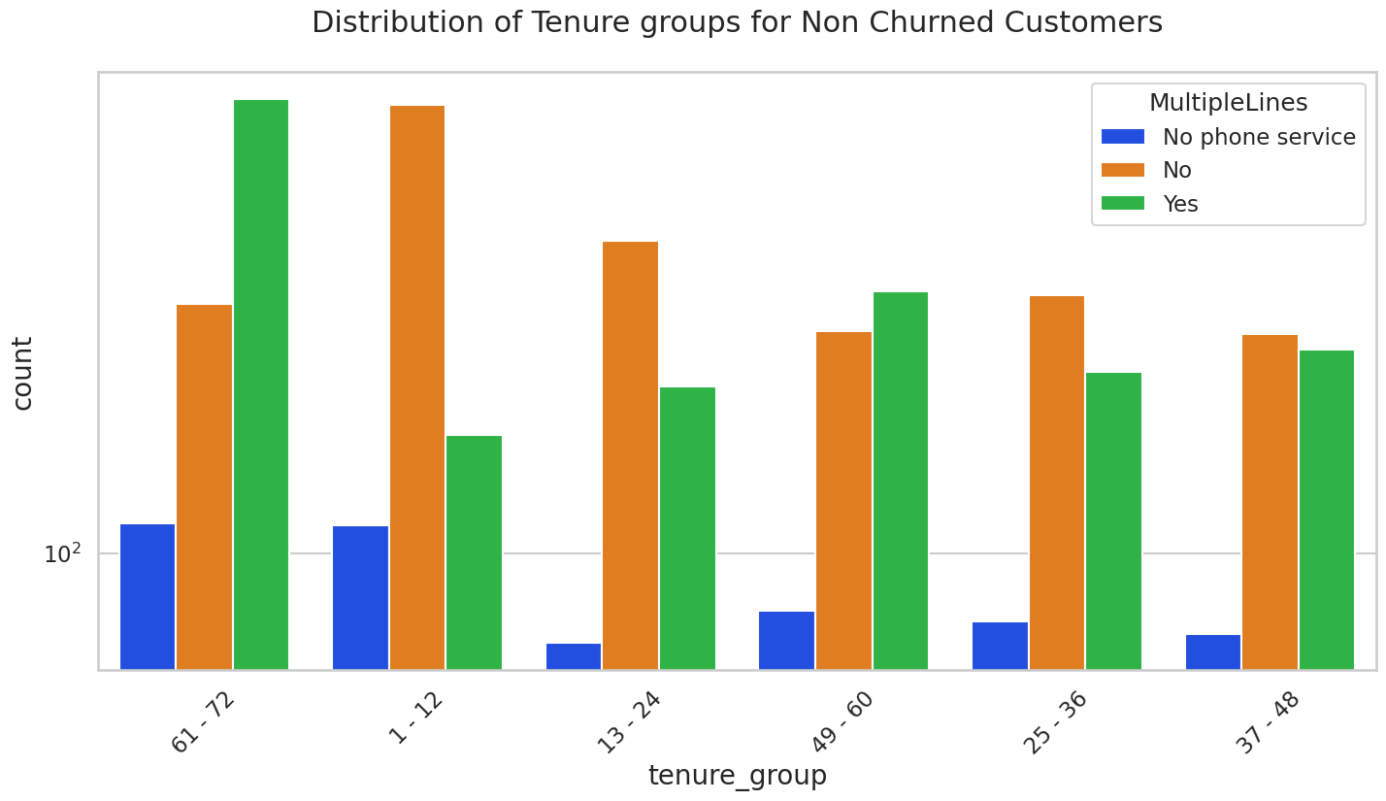
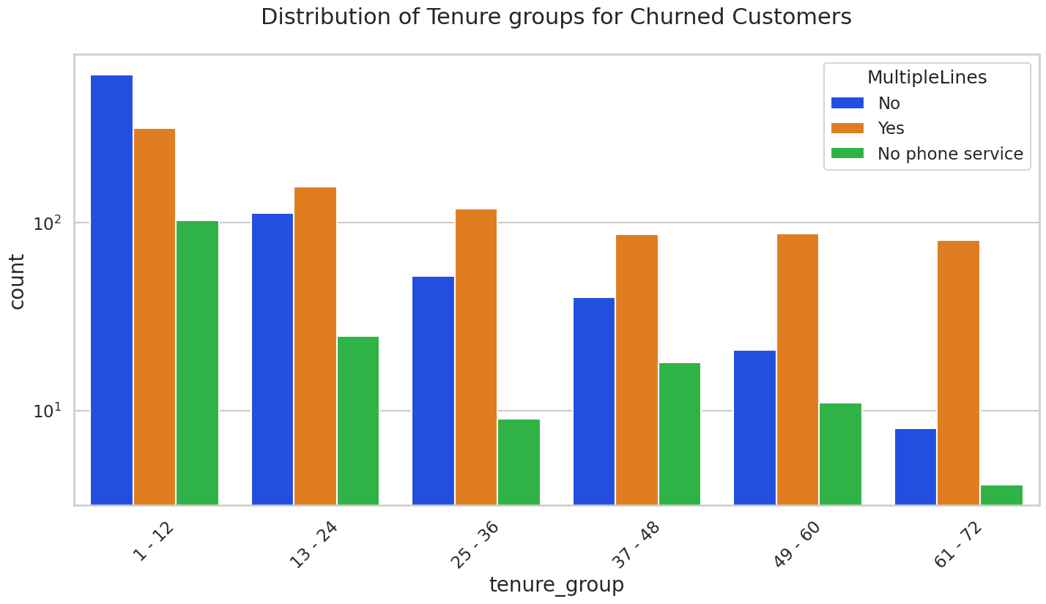
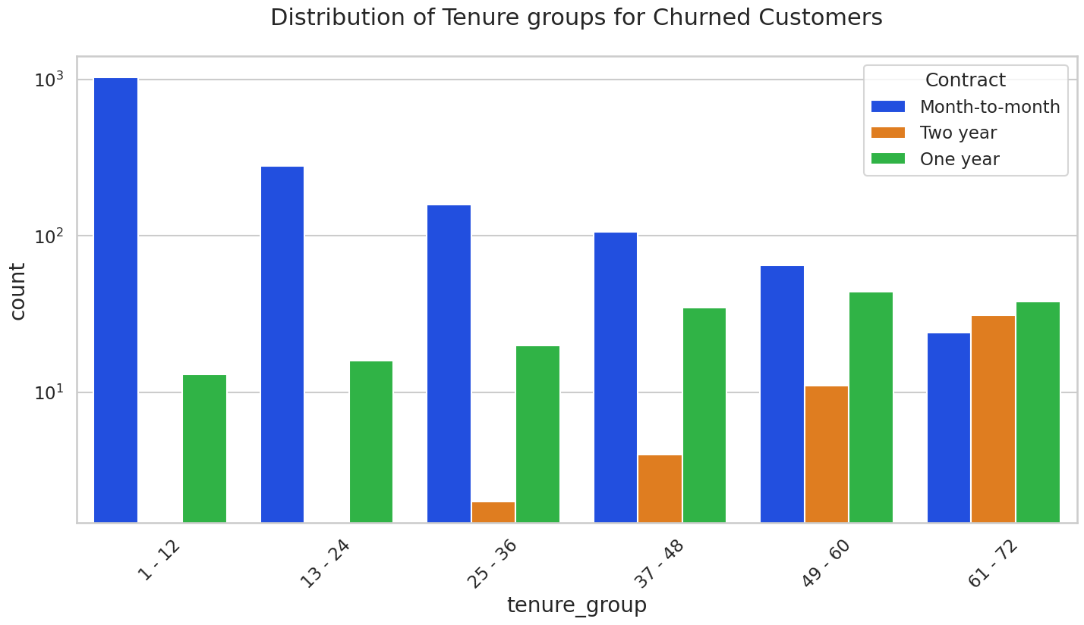
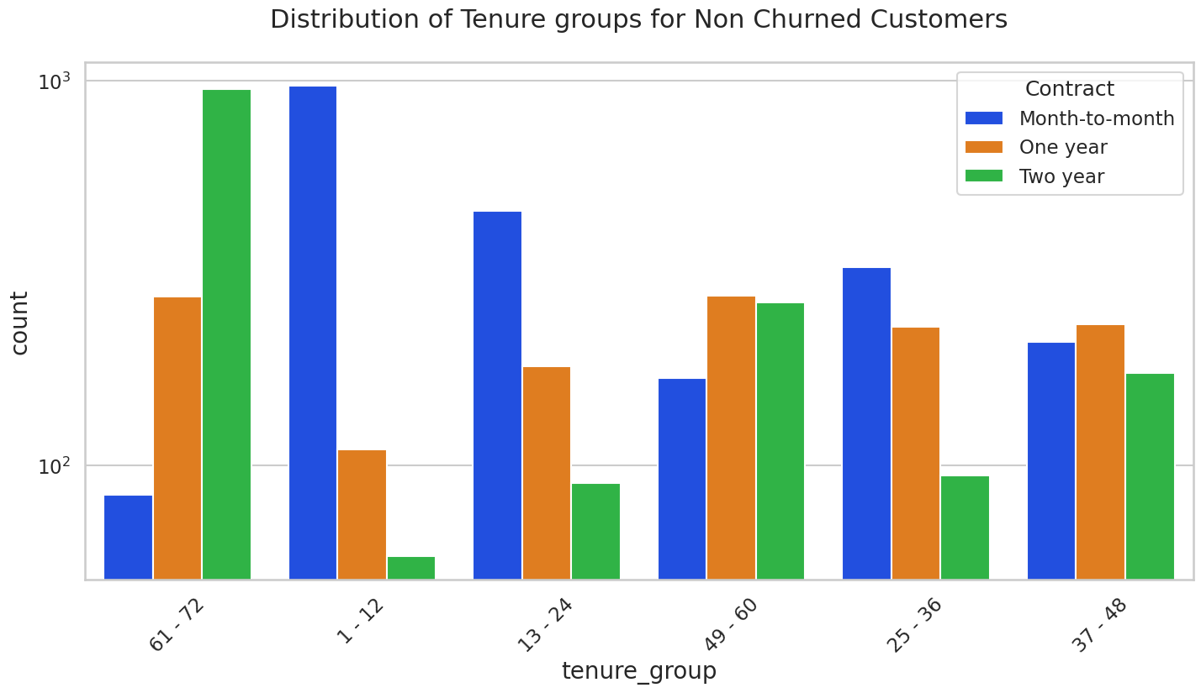
Findings:
Consumers on month-to-month contract are more likely to churn regardless of their tenure length and whether they use multiple lines.

Slide 18
Bivariate Analysis Insights:
Gender does not have any significant impact on tendency to churn among all age groups and other personal factors such as dependents and presence of partner, only a slight increase in churn likelihood is evident in case of males without partner.
Customers without Online security, No Tech support, No Online Backup and No Device protection show higher tendency to churn compared to those without any internet connection.
Customers using Fiber optic service are more likely to churn.
Churn rate is very low with No Internet subscription.
Consumers on month-to-month contract are more likely to churn regardless of their tenure length and usage of multiple lines.
Customers using Electronic check payment methods are more likely to churn regardless of age, gender or tenure length.
Females using credit cards for payments show higher chances of churn.

Slide 19
Conclusion:
High Churn seen in customers :
Who lack Online security, Tech support, Online Backup and Device protection
Using Fiber optic service
Month-to-month contract
Are senior citizens.
Shorter tenure (Tenure range: 1–12-month).
Paying elevated monthly charges.
Paying via Electronic check payment method.
Low Churn evident in :
Users with a lengthy tenure demonstrate a lower likelihood of churning.
The churn rate is minimal among those who do not have an active internet subscription.
No Impact:
Factors like Gender, Availability of Phone Service and multiple lines have insignificant impact on churn.

Slide 20
Next Steps: Ensuring optimal customer retention is crucial.
Internet subscribers should be provided with online amenities like Technical Assistance, Digital Security, Cloud Backup, and Device Safety.
1
Promoting the adoption of automated payment modes like bank transfers and credit cards could yield positive outcomes.
2
Encouraging users to choose yearly agreements instead of monthly contracts.
3
Enhanced discounts should be extended to elderly users.
4
Increased incentives for new subscribers, is recommended.
5
Enabling customers to freely transition between DSL and fiber optics services based on their preferences.
6

Slide 21

Thank you!

